Slide 1
Visualizing and building statistical models on multivariate data
Anthony Fodor
Bioinformatics and Genomics
UNC Charlotte
http://afodor.github.io/classes/ChapelHill2018/ch.pptx

Slide 2
This is a “choose your own adventure” workshop (you can do any or all of the below):
(1) Examine data in R:
You will need
Some version of R
Some text editor (sublime is a very nice choice, or e-macs or vi or r-studio)
(2) Examine data in our “in development” point and click environment
You will need:
A recent version of R
Install our “plotmicrobiome” package
(probably) some patience as our tool is still in development
(3) Let the data and presentation “roll over” you…
You can use our (provided) data or (if you have a counts table) try to analyze your own…

Slide 3

If you are following along with our datasets…
We will be using the data from this paper…
https://microbiomejournal.biomedcentral.com/articles/10.1186/s40168-017-0338-7

Slide 4
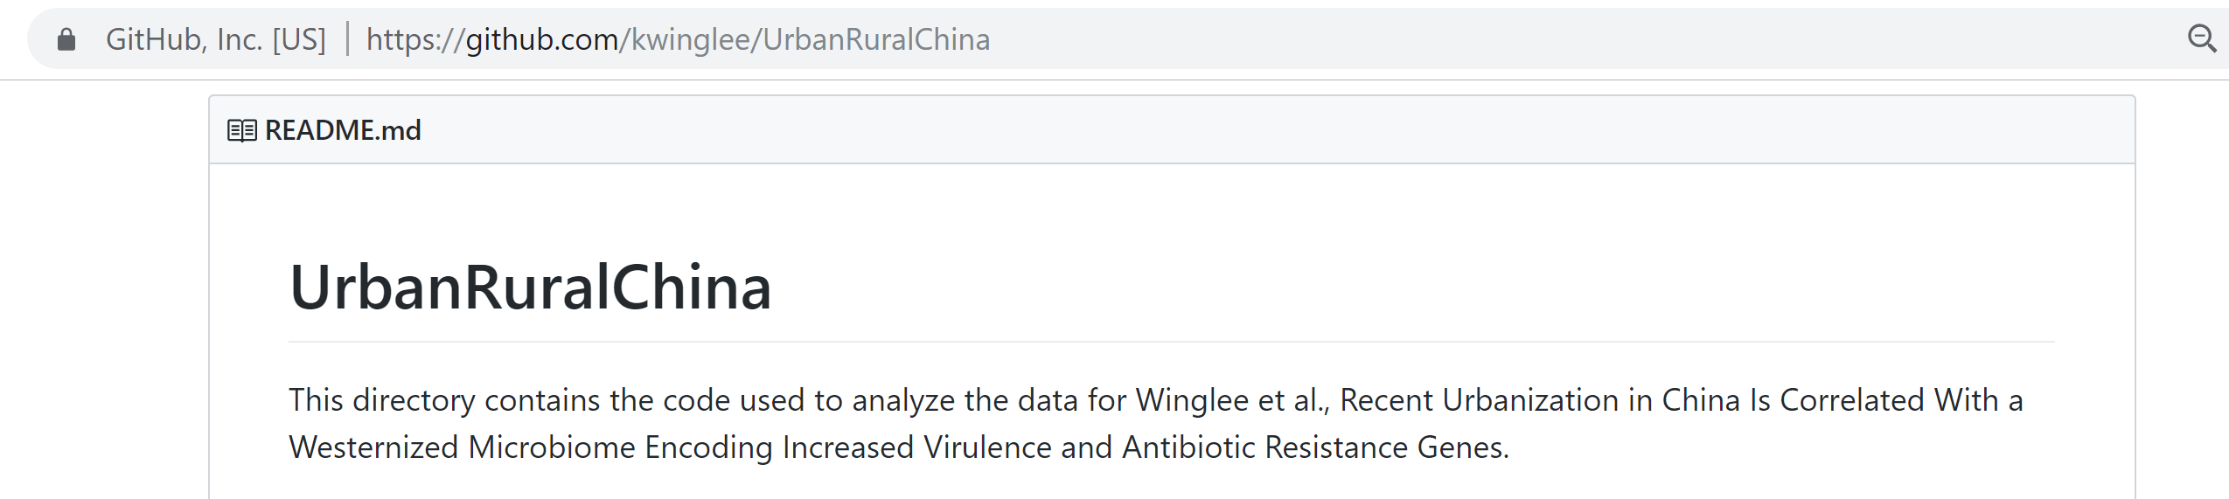
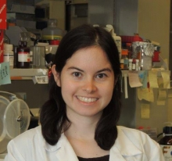
Tables and r-scripts were nicely organized by Kathryn Winglee (now of the CDC in Atlanta)
https://github.com/kwinglee/UrbanRuralChina

Slide 5
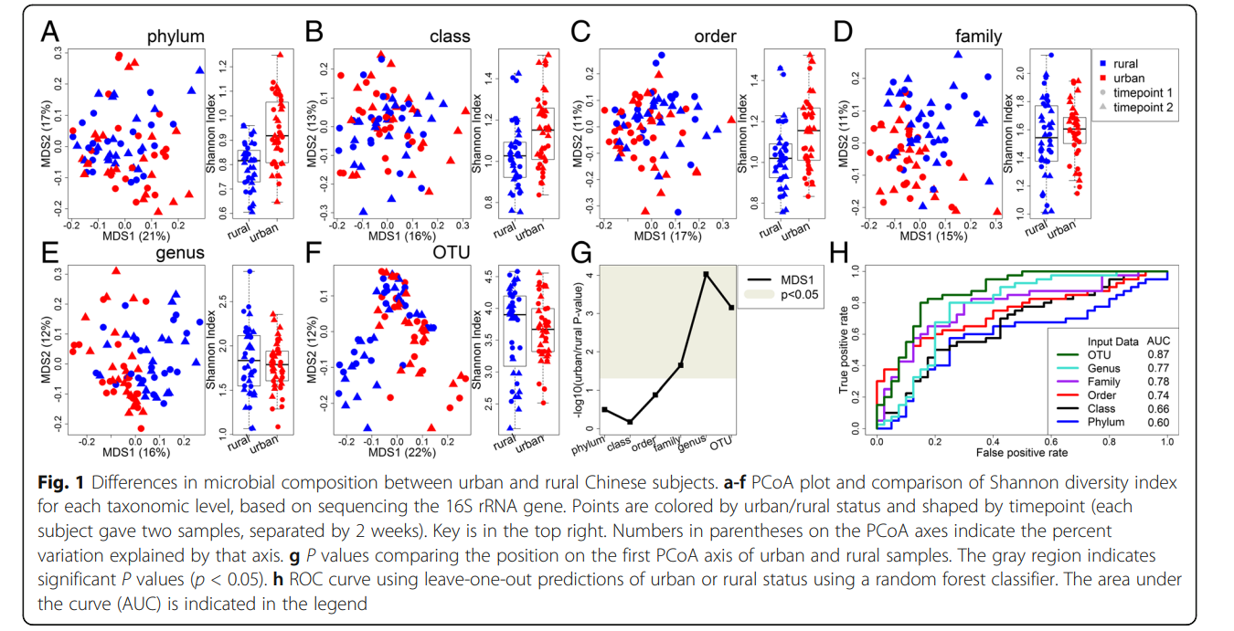
We are going to see how to recreate the visualizations in the first figure of this paper

Slide 6
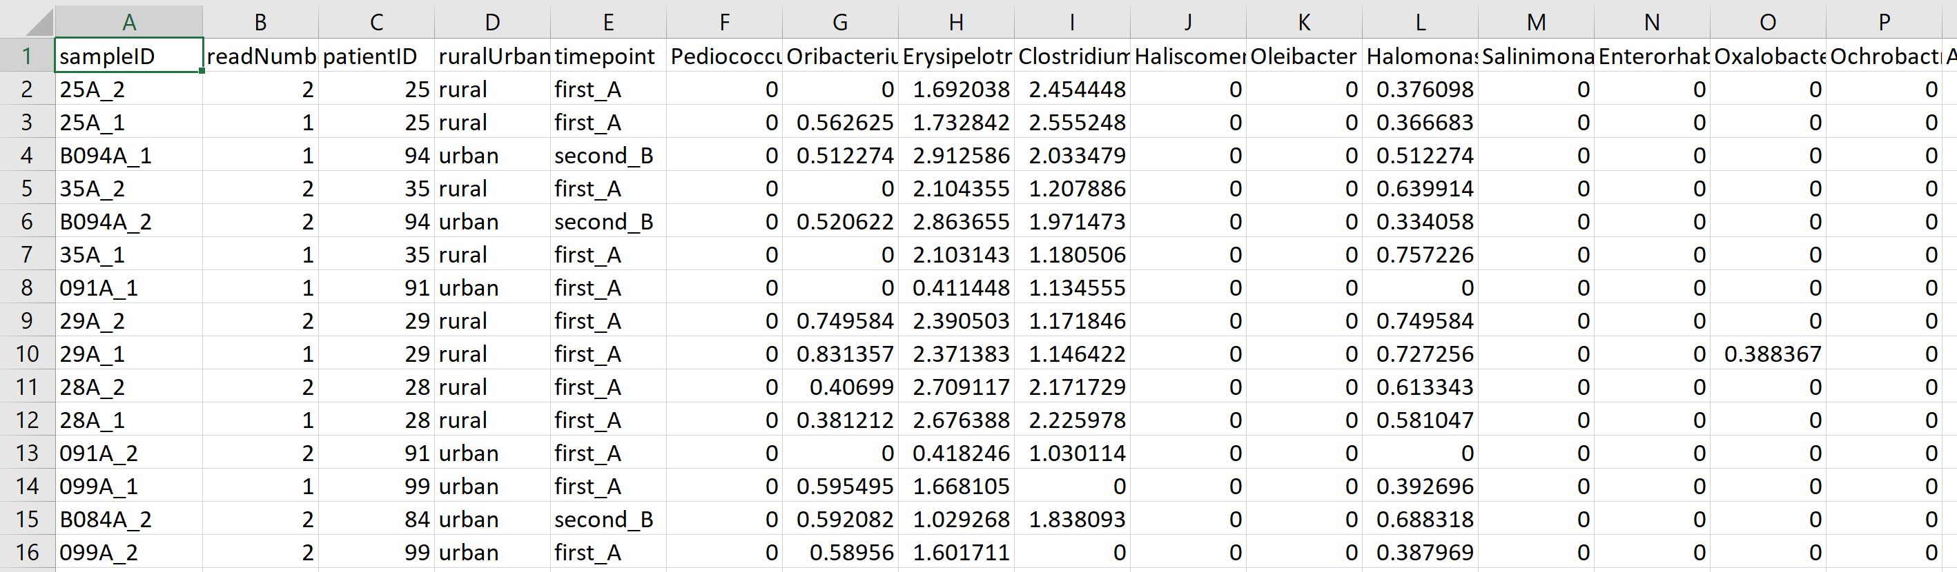
We will use this spreadsheet as our base input into R…
https://github.com/kwinglee/UrbanRuralChina/blob/master/16SrRNA/inputData/RDP/genus_taxaAsColumnsLogNorm_WithMetadata.txt

Slide 7
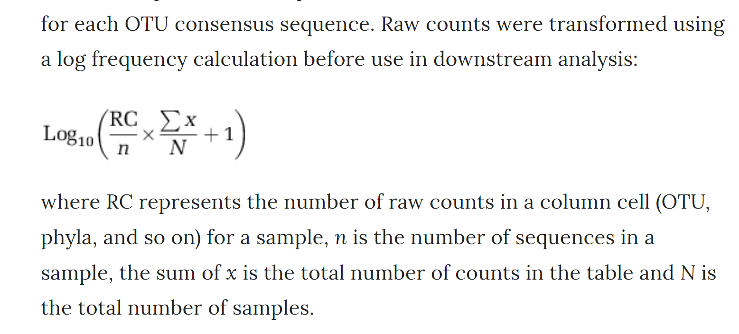
This spreadsheet has the following features:
The taxa are columns; the rows are samples
The metadata (urban vs. rural, timepoint) are in the same spreadsheet as the relative abundance
The counts are log-normalized according to the following formula
https://www.nature.com/articles/ismej2013106

Slide 8
If you have your own dataset…
We can work with you to get your data into the same format
(or to modify your R code to work with your table!)

Slide 9
Normalizing your data
PCA Ordination
Graphing everything into one big PDF ball
Some Simple Statistical Models
Some Not So Simple Statistical Models

Slide 10
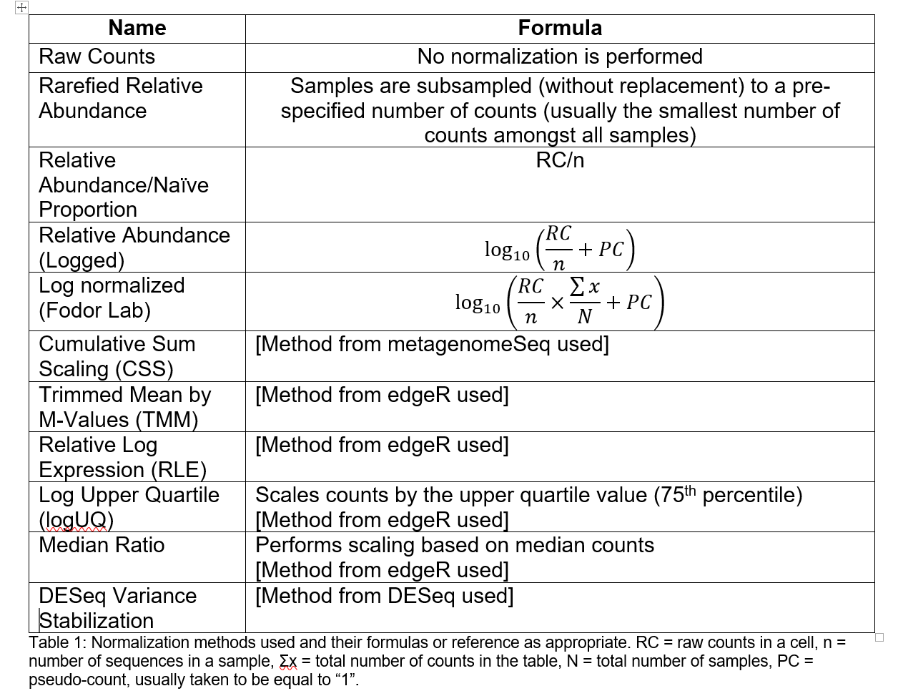
You will need to choose some normalization scheme..
(Each sequence library will be of a different depth; you need to correct for that)
The easiest (not necessarily the best) approach is to divide each cell by the total # of sequences in that sample.
This is relative abundance
Table due to :Matthew C. B. Tsilimigras (Matthew C. Brown)

Slide 11
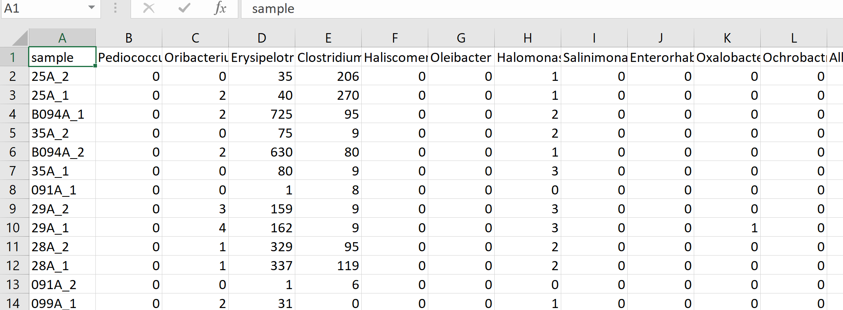
Let’s say you have a spreadsheet that is un-normalized and you want to change it to log relative abundance
https://github.com/kwinglee/UrbanRuralChina/blob/master/16SrRNA/inputData/RDP/genus_taxaAsColumns.txt

Slide 12
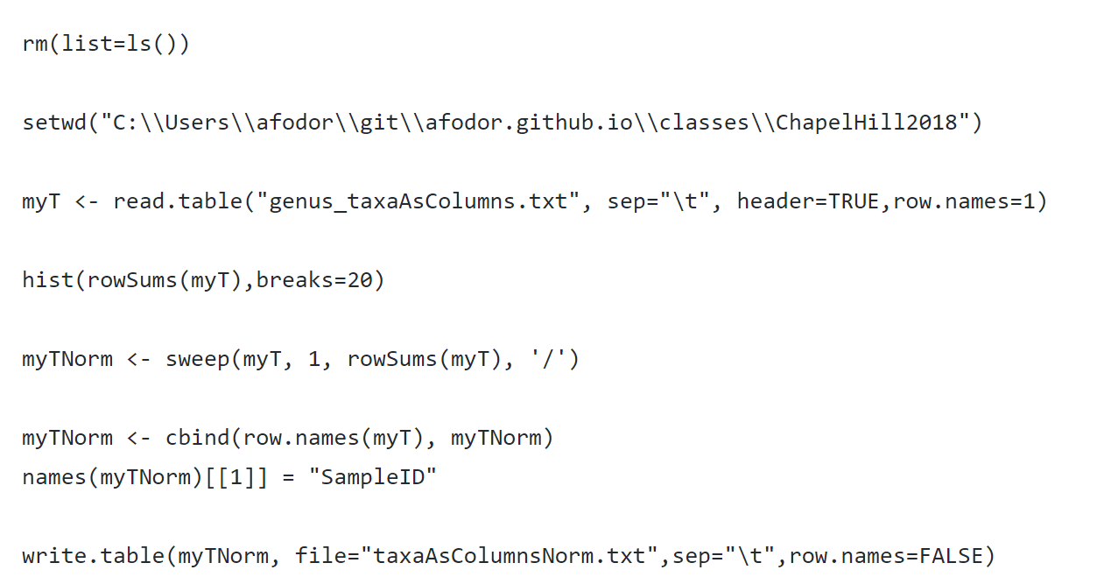
Here is a (complete) R script to convert a counts table to relative abundance and write the results to a file
https://github.com/afodor/metagenomicsTools/blob/master/src/classExamples/ch2018/quickNormalization.txt

Slide 13
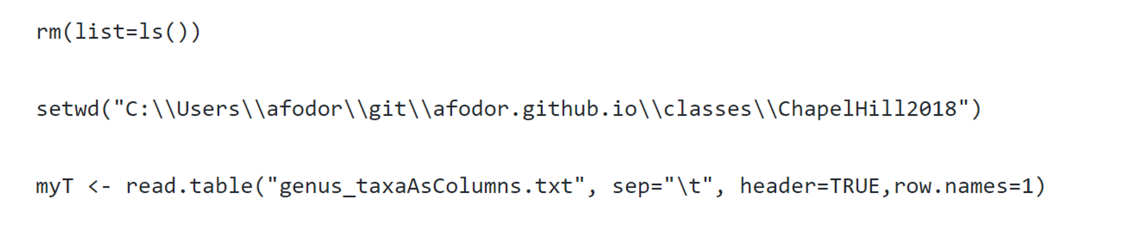
The first few lines input the file we wish to normalize

Slide 14
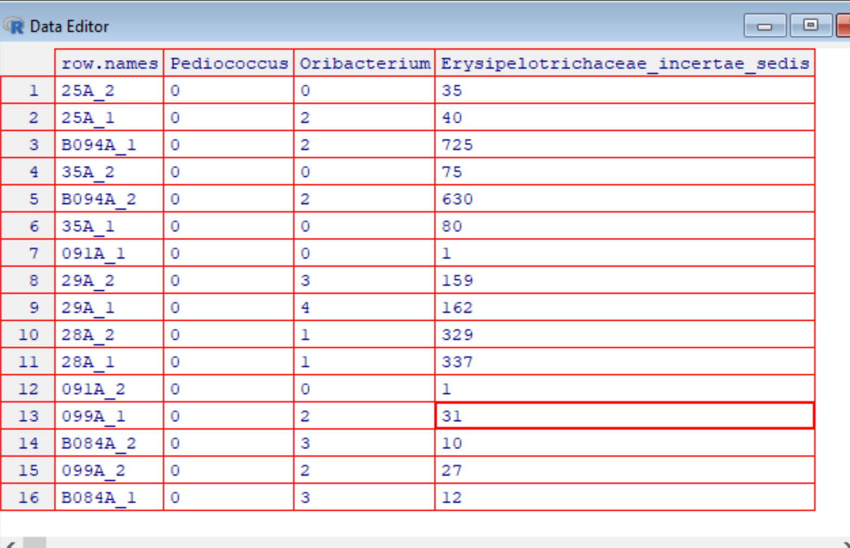
On Windows (but not necessarily in Macs or in R-studio, I get this nice view when I type
edit(myT)
Interestingly, changes I
type here don’t persist.
(I would have to type
myT <- edit(myT))
to have the changes
I type into the
spreadsheet stick.
This is because data
structures in R are
Immutable!

Slide 15
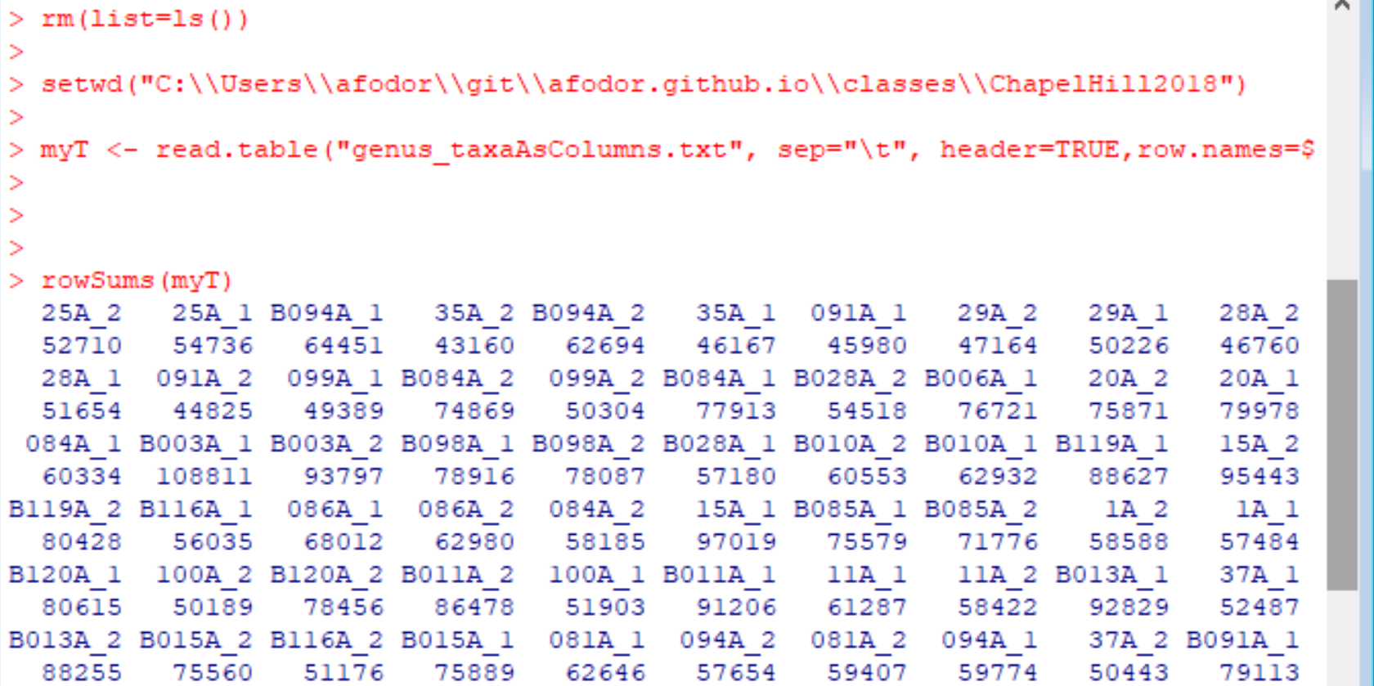
If I type
rowSums(myT)
R gives me the sequencing depth per sample

Slide 16
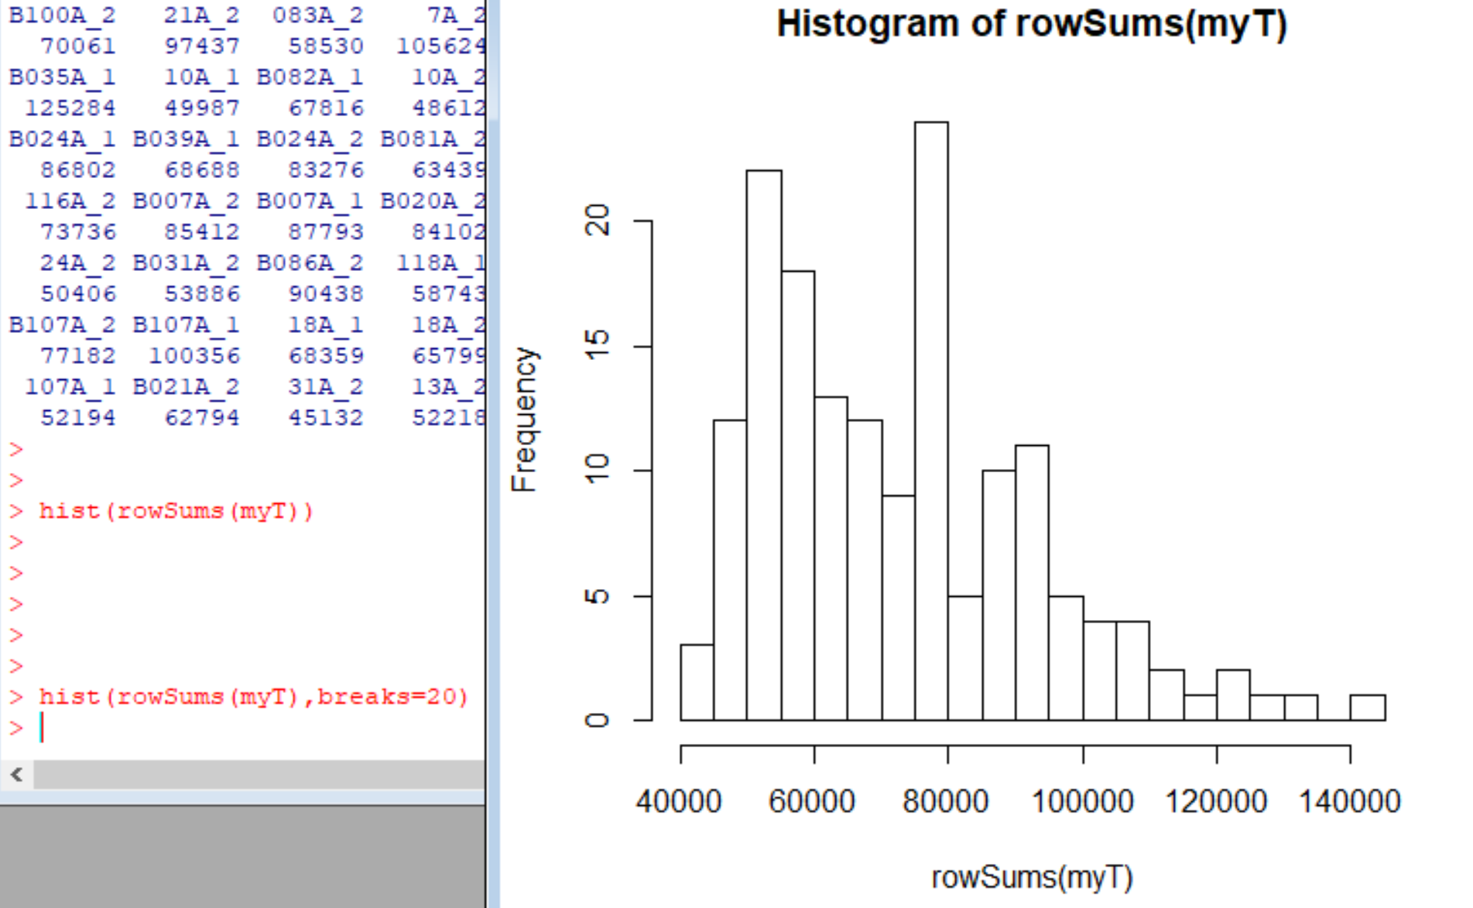
If I type
hist(rowSums(myT))
I get a nice graphic of my sequencing depth per sample. Very easy, informative QA/QC

Slide 17
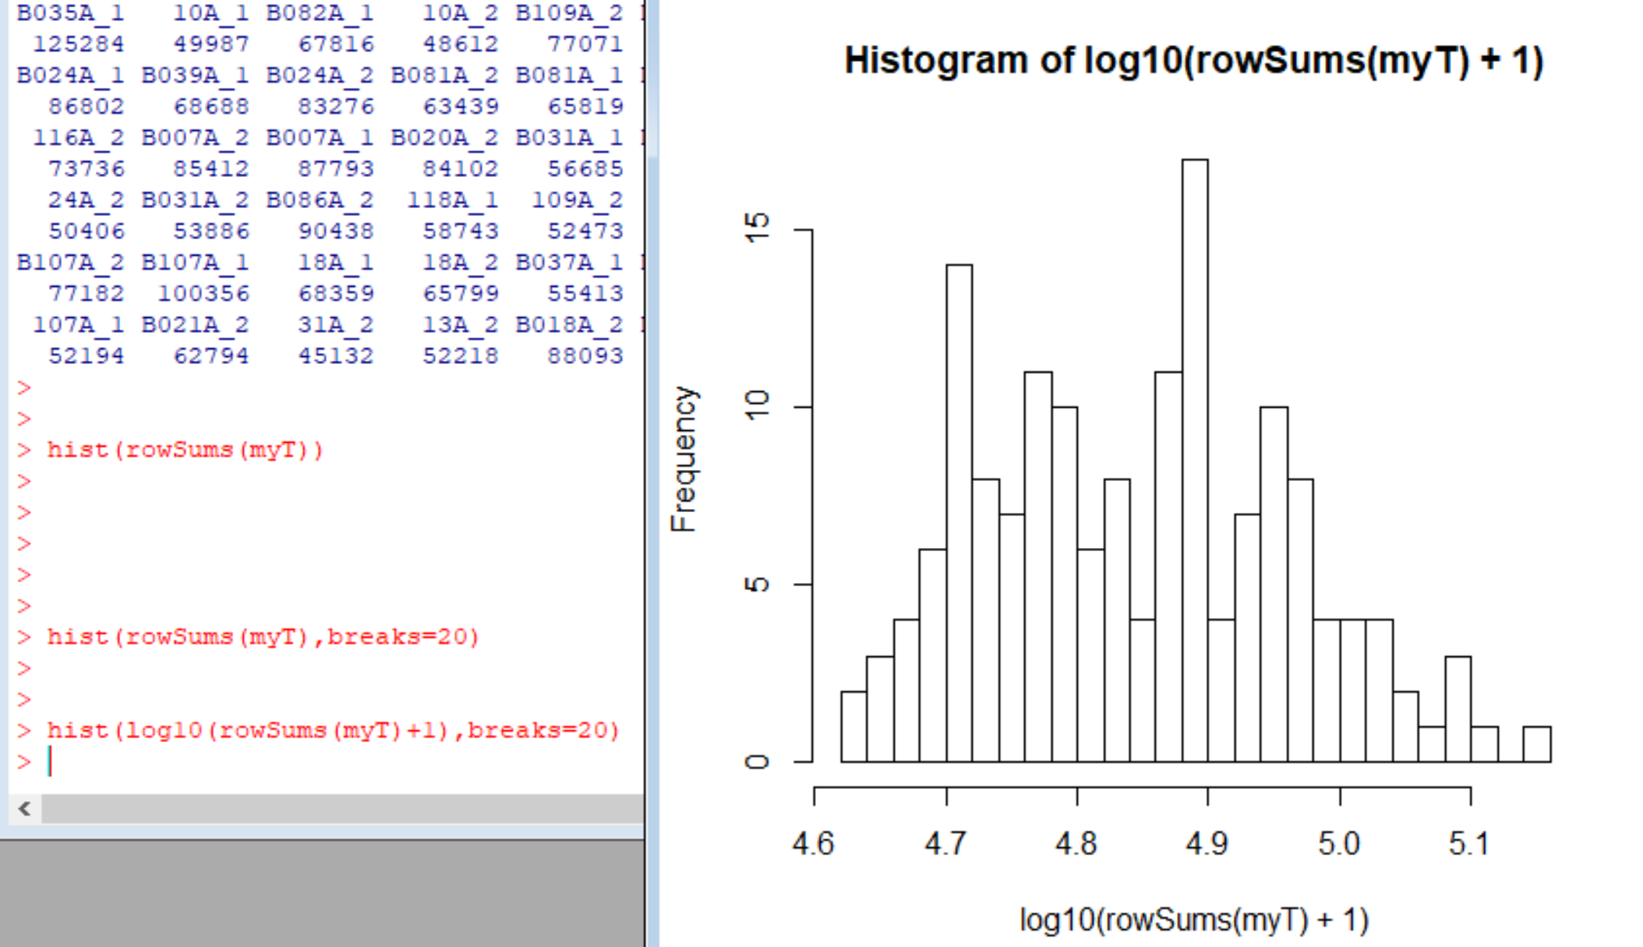
Alternatively, I can easily switch to a log scale…

Slide 18
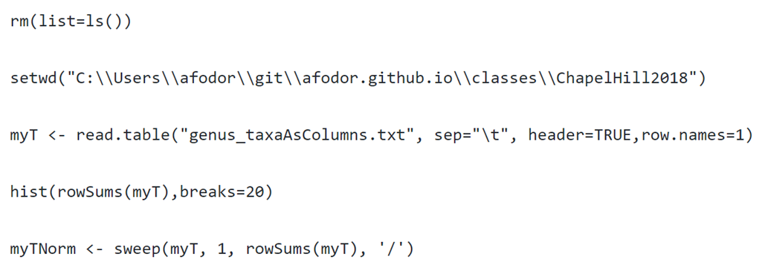
I can use the rowSums directly to switch to relative abundance

Slide 19
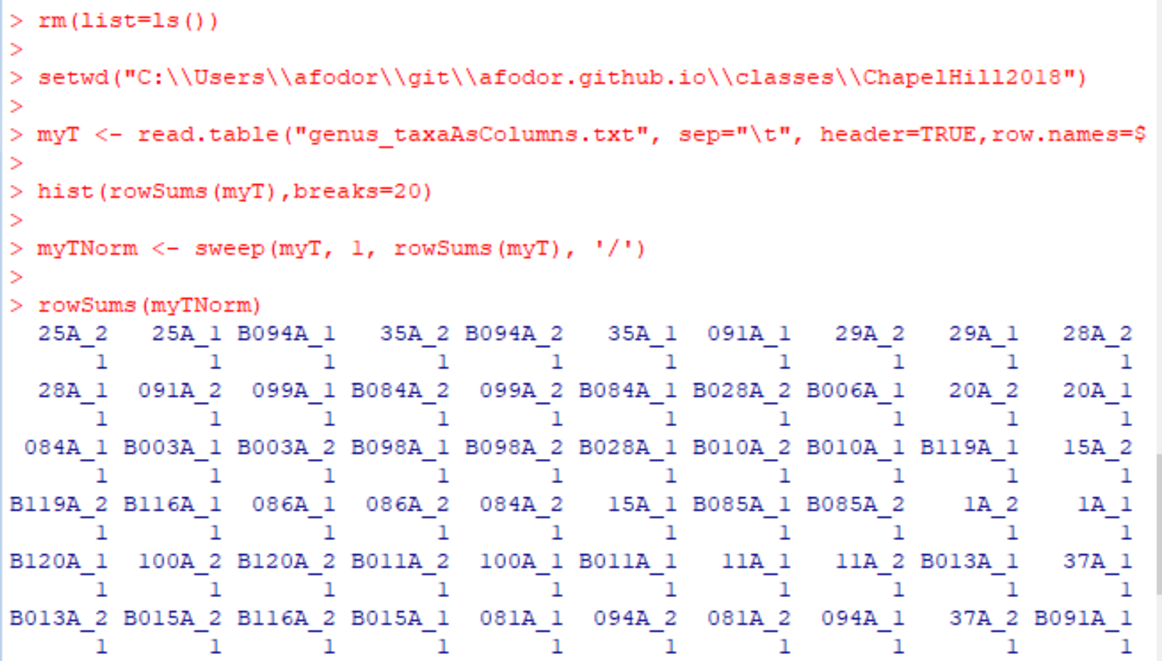
The rowSums on myTNorm should all be 1 (and they are)

Slide 20
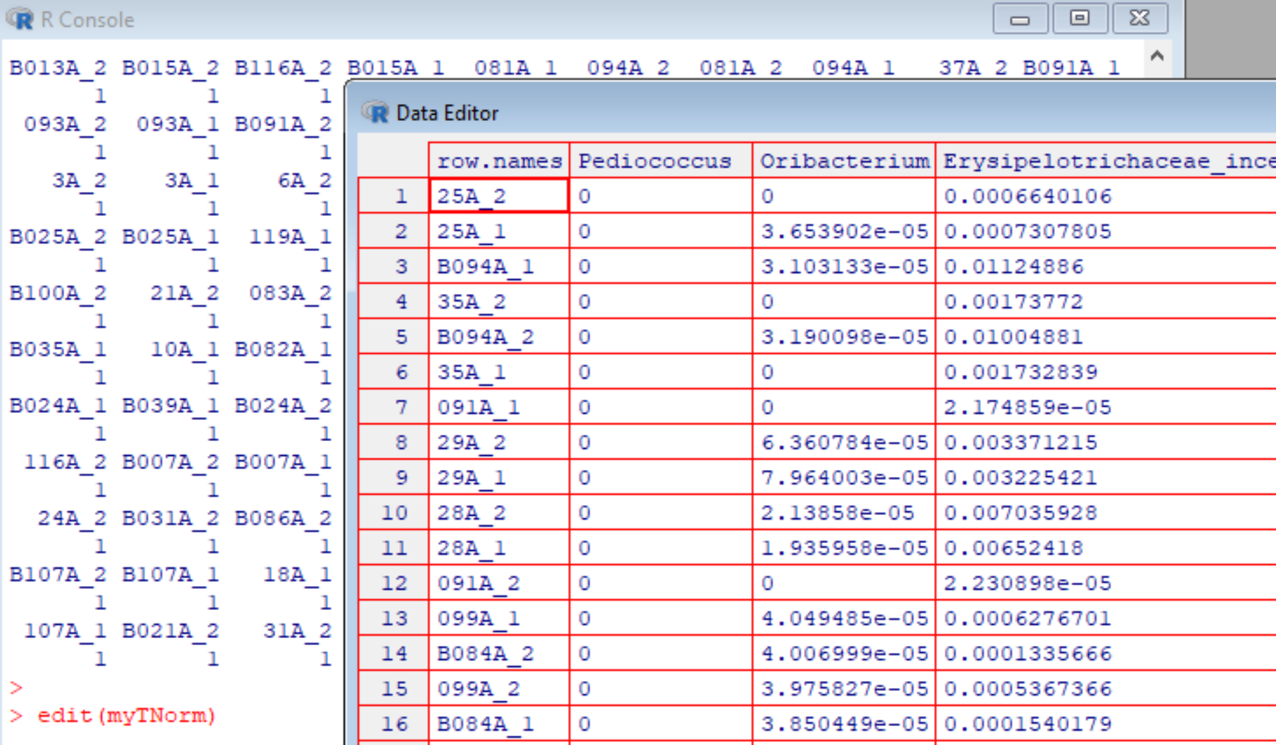
myTNorm is now in relative abundance

Slide 21
Finally, we want to be able to write our normalized file to an output file.
This is a little more involved than it seems like it should be
(learning R is mostly learning stupid R tricks…)
R by default will not give the sampleIDs a
column header.
This hacks around that default behavior

Slide 22
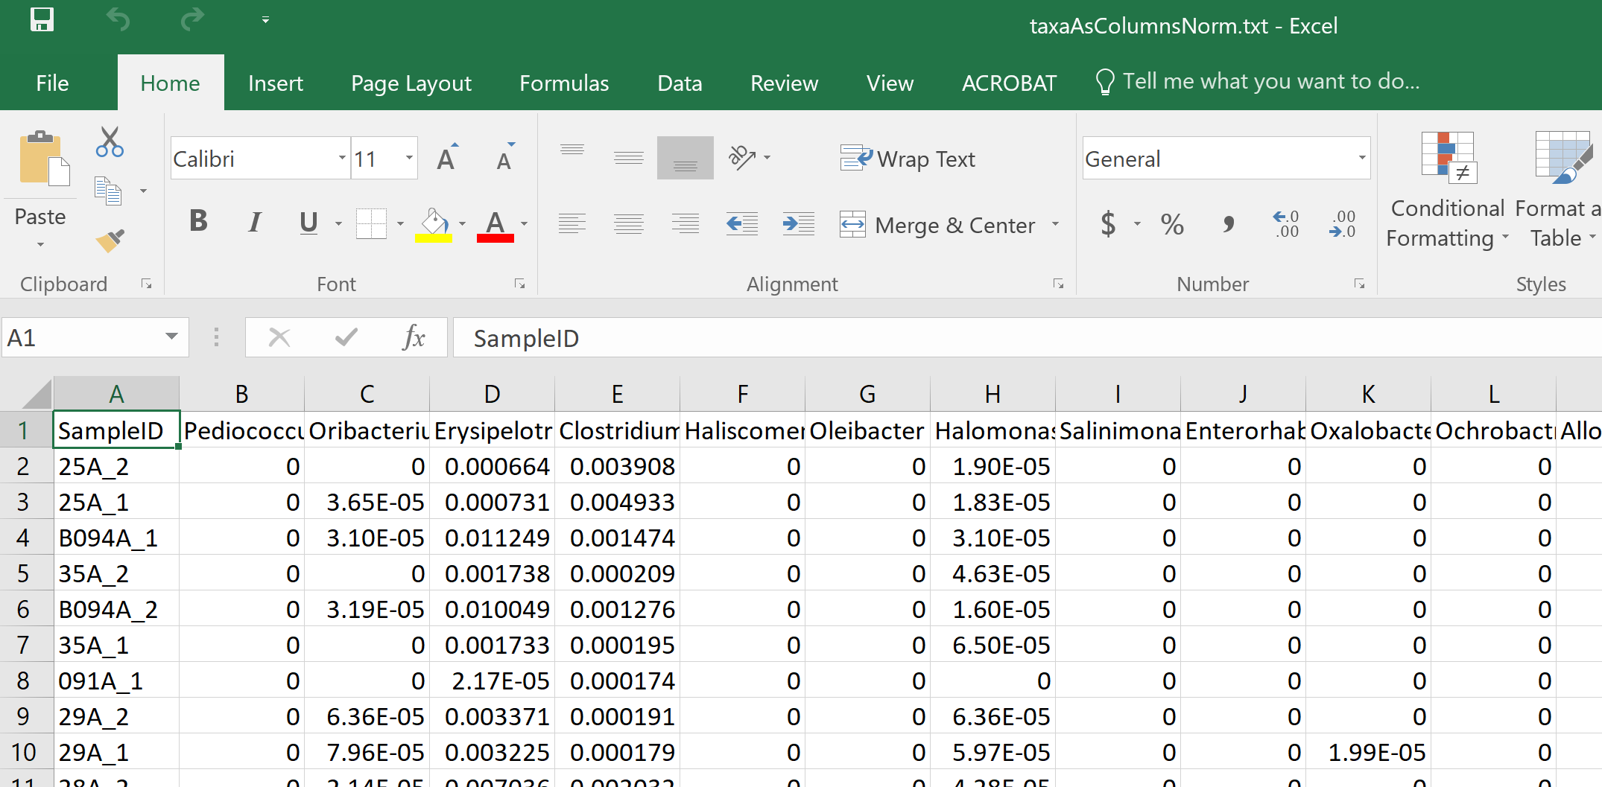
We end up with a text file in our working directory that can be imported into Excel (or wherever)

Slide 23

We can likewise prep our data in our “plot microbiome” tool
Install directions are here: https://github.com/ssun6/plotmicrobiome
(On windows missing packages need to be added from Bioconductor ):
So after install run:
if (!require("BiocManager", quietly = TRUE))
install.packages("BiocManager")
BiocManager::install("ggtree")
BiocManager::install("rhdf5")
And re-run…
Shan Sun UNCC

Slide 24
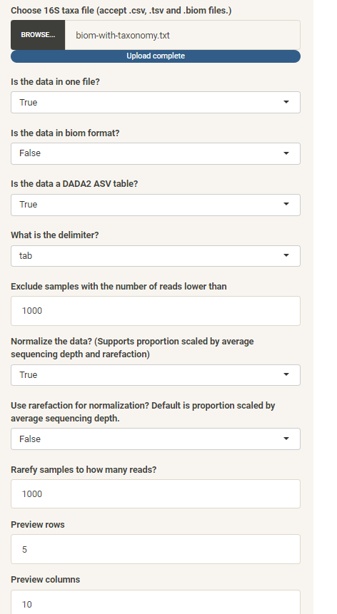
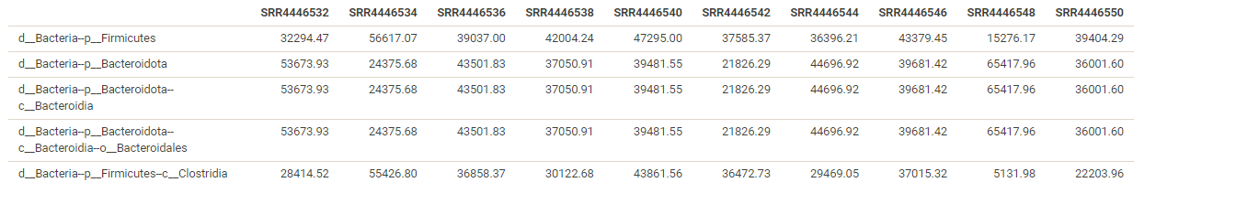
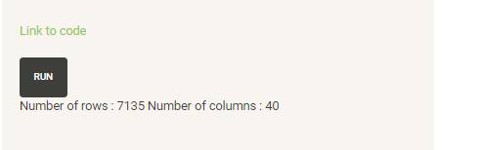
First we load in raw sequence data (which will be normalized)
Hit run
https://fodorclasses.github.io/classes/premier_2023/biom-with-taxonomy.txt

Slide 25
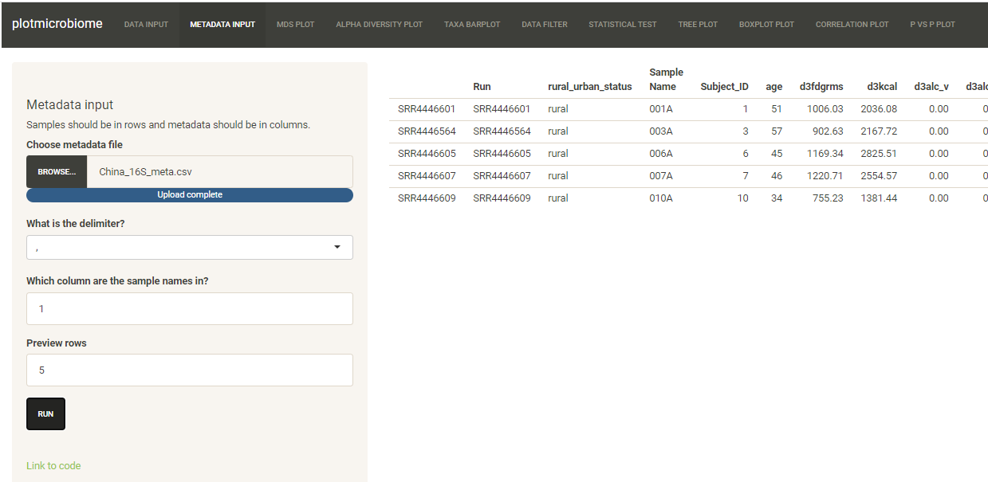
Next we load the metadata…
https://fodorclasses.github.io/classes/premier_2023/China_16S_meta.csv

Slide 26
Normalizing your data
PCA Ordination
Graphing everything into one big PDF ball
Some Simple Statistical Models
Some Not So Simple Statistical Models

Slide 27
There are about 340 taxa in our spreadsheet.
We can’t make a 340 dimensional graph
We can use ordination to reduce the dimensionality (and complexity of our dataset)

Slide 28
We can use ordination to reduce the dimensionality of our complex data
We can go from a (20 * 340 ) spreadsheet to a ( 20* 2 ) spreadsheet.
This will allow us to better see what is going on with our data…

Slide 29
Ordination is a form of data compression
We know data compression from music and photos…
A song on a CD might be 350 MB (megabytes) big.
But we compress the song to an MP3 for our phone so that is only, maybe 6 MB big.
The compression captures what is essential about the song, but in less space.
Potentially, the more we compress, the worse the song sounds!
Our ordination attempts to capture what is essential in our ~340 taxa, but in 2 columns.
We can do this by taking advantage of duplicate information.
Imagine all the 340 taxa are highly correlated. We could remove the extra information
from those columns and still have all the important information in the spreadsheet with much less space…
( A more mathematical treatment describing the
compression is here: http://afodor.github.io/classes/stats2015/Lecture19.pptx )

Slide 30
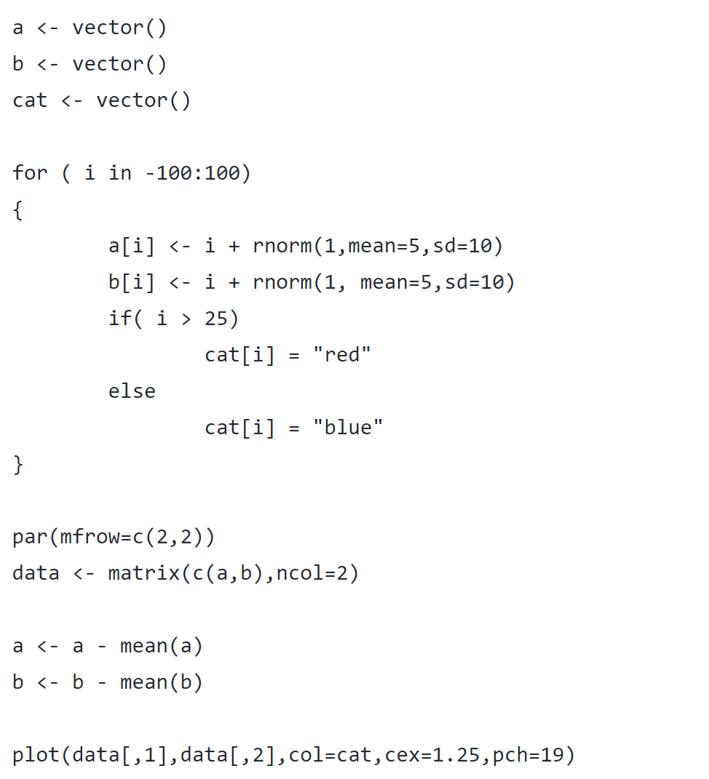
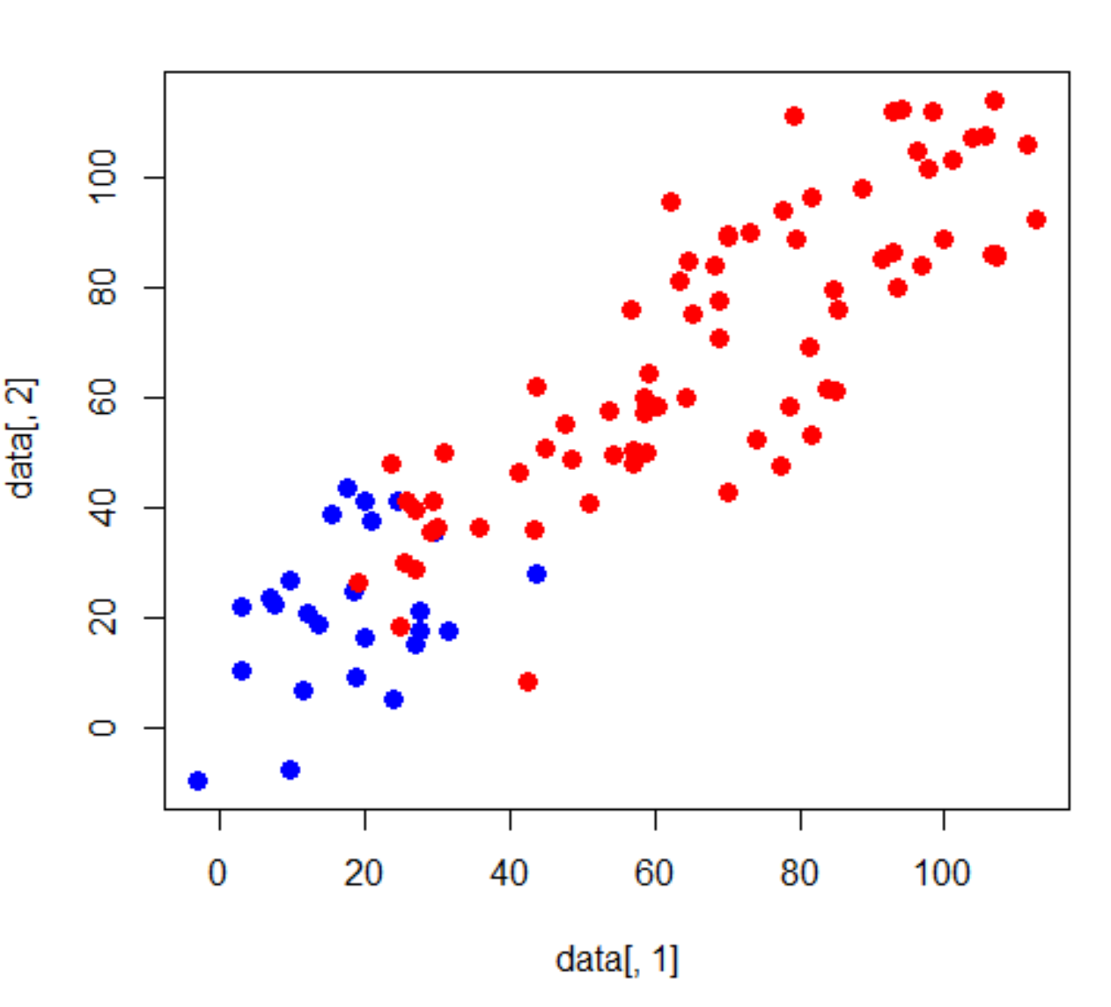
Consider a simulated 2D dataset
https://github.com/afodor/metagenomicsTools/blob/master/src/classExamples/pcaSim.txt

Slide 31
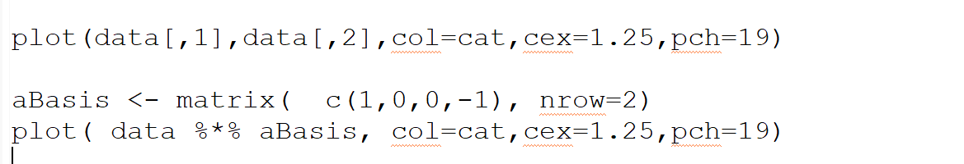
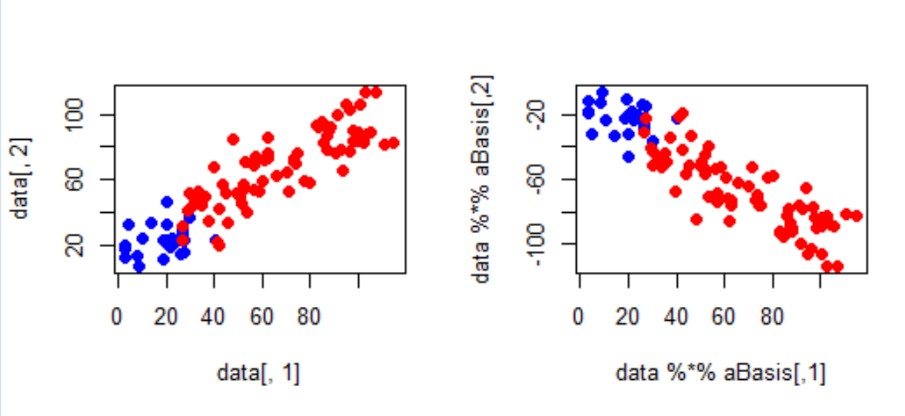
We can rotate these data any way we want to (by any orthornomral basis)
Before rotation
After rotation

Slide 32
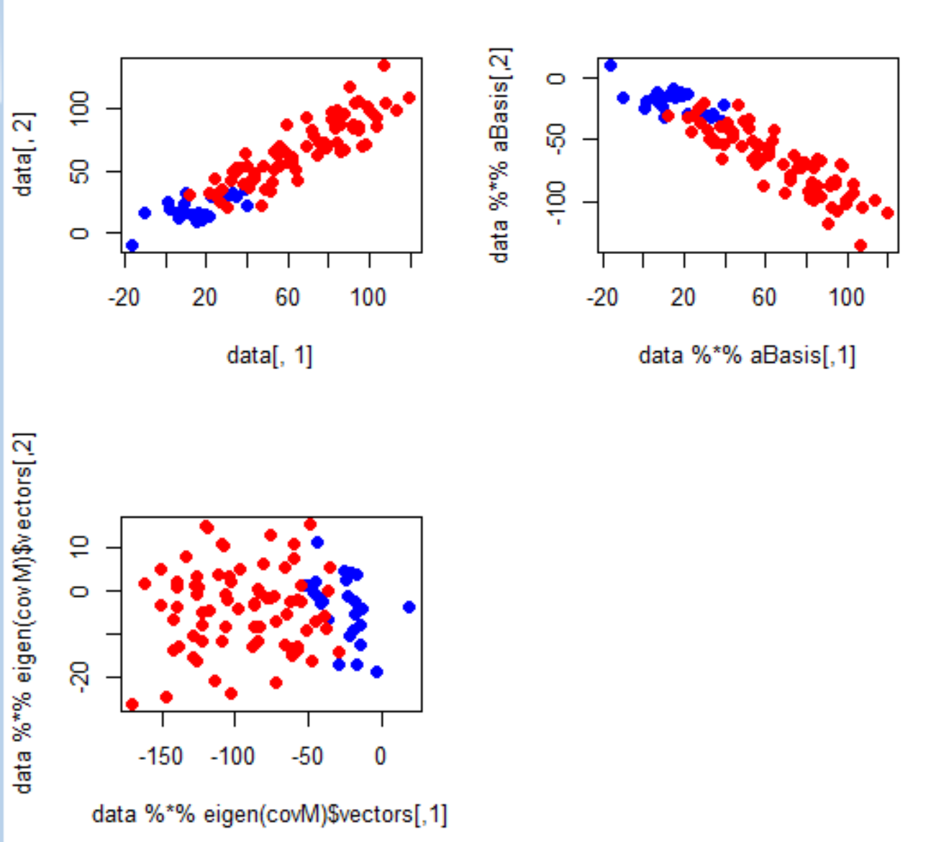
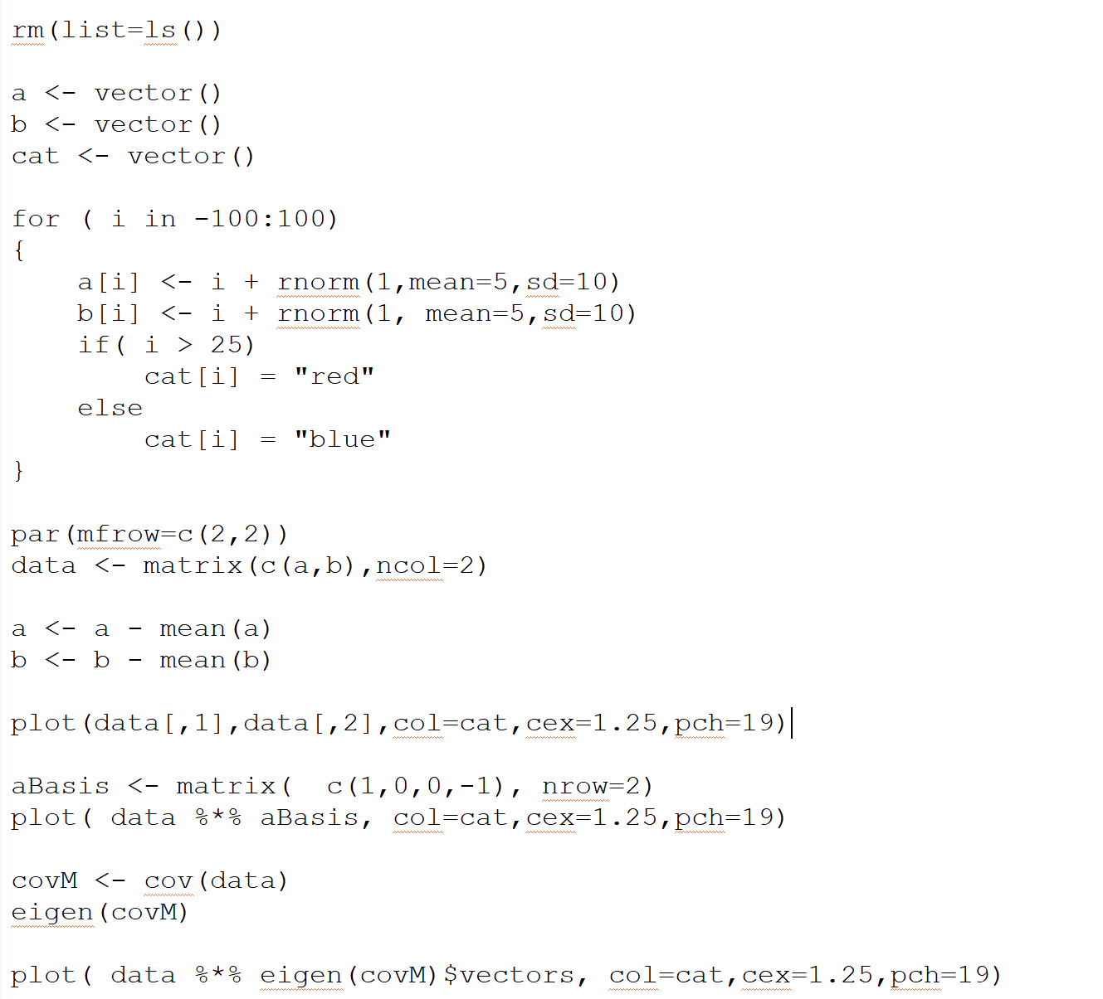
The PCA rotation is the rotation that guarantees that PCA1 will capture the most possible variance of the data in one dimension
We have the option of doing inference (comparing for example red. vs. blue)
in one-dimension (with, for example, a simple t-test) even though we started with
two correlated variables)

Slide 33
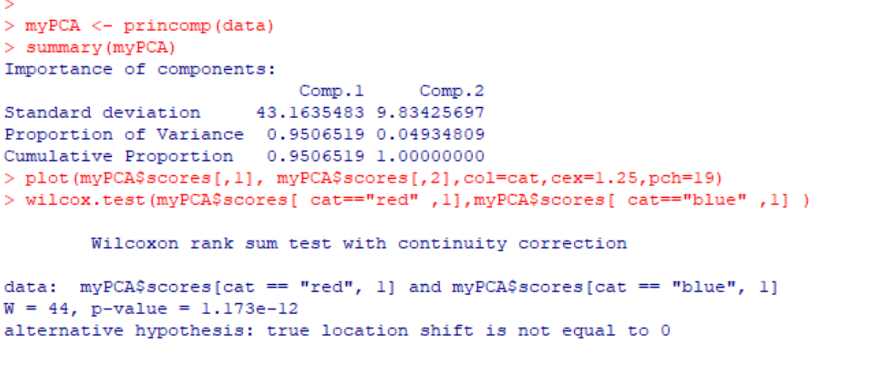
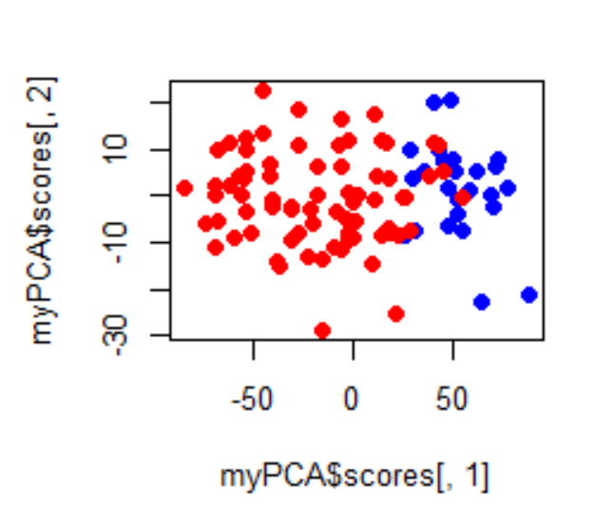
We have the option of doing inference (comparing for example red. vs. blue)
in one-dimension (with, for example, a simple t-test) even though we started with
two correlated variables)

Slide 34
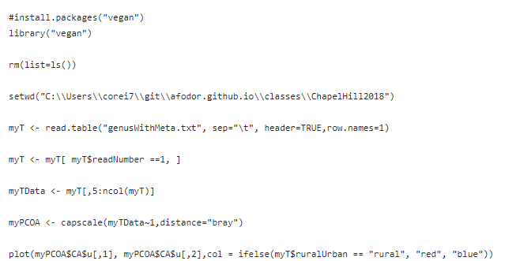
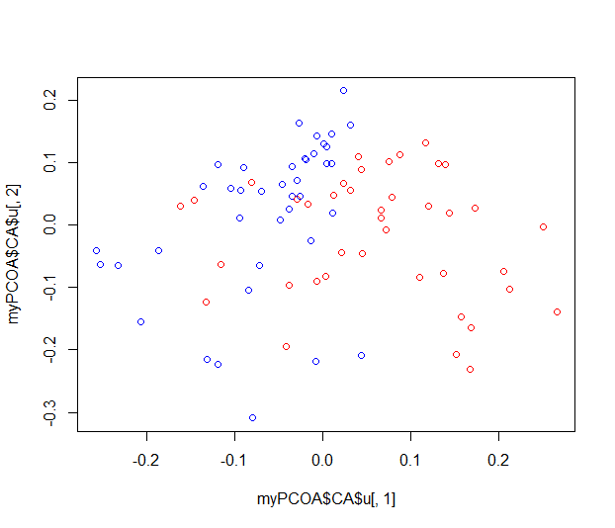
Here is a complete script for data ordination from a (in this case) log-normalized data file…
https://github.com/afodor/metagenomicsTools/blob/master/src/classExamples/ch2018/quickOrdination.txt

Slide 35
The library that will run our ordination. Uncomment this the first time
you run your program to download and install the program
https://github.com/afodor/metagenomicsTools/blob/master/src/classExamples/ch2018/quickOrdination.txt

Slide 36
This line tells R to load the “vegan” library into memory
https://github.com/afodor/metagenomicsTools/blob/master/src/classExamples/ch2018/quickOrdination.txt

Slide 37
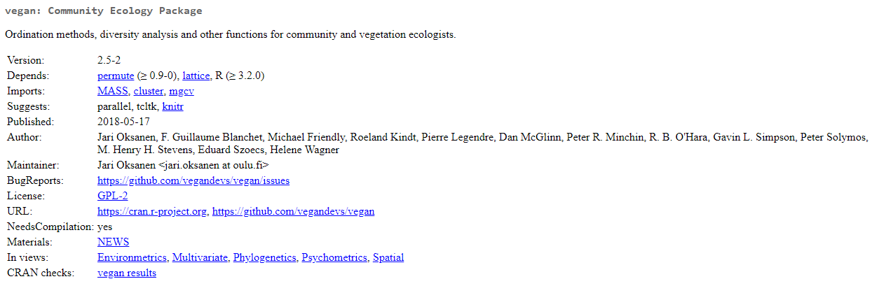
The vegan package has many useful tools for dealing with ecology count data
(like sequencing data from metagenomics)

Slide 38
As before we start R in a clean state (we would not do this if this were part of a larger suite)
https://github.com/afodor/metagenomicsTools/blob/master/src/classExamples/ch2018/quickOrdination.txt

Slide 39
And we tell R where we have the data
(this can alternatively be a URL)
https://github.com/afodor/metagenomicsTools/blob/master/src/classExamples/ch2018/quickOrdination.txt

Slide 40
As before we read our data into R
https://github.com/afodor/metagenomicsTools/blob/master/src/classExamples/ch2018/quickOrdination.txt

Slide 41
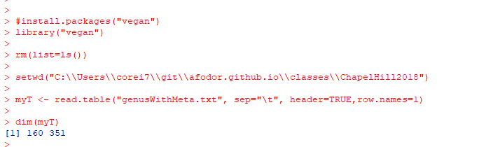
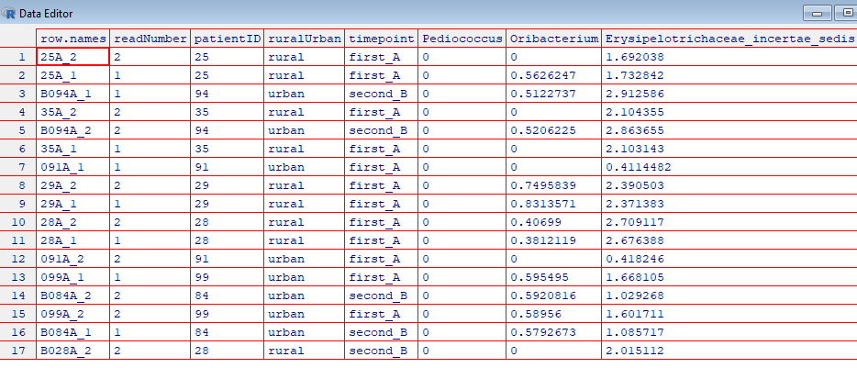
At this point in our program, our spreadsheet has 160 samples (rows) and > 340 taxa (columns)
edit( myT)
This spreadsheet
has both the forward
and backwards reads;
We want to filter out
the forward reads

Slide 42
Here we only keep the rows where the readNumber == 1
https://github.com/afodor/metagenomicsTools/blob/master/src/classExamples/ch2018/quickOrdination.txt

Slide 43
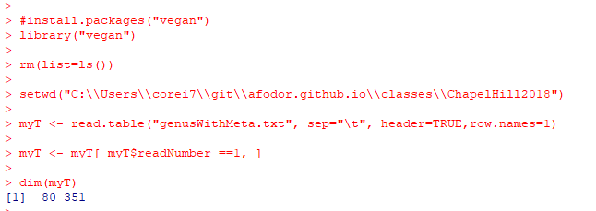
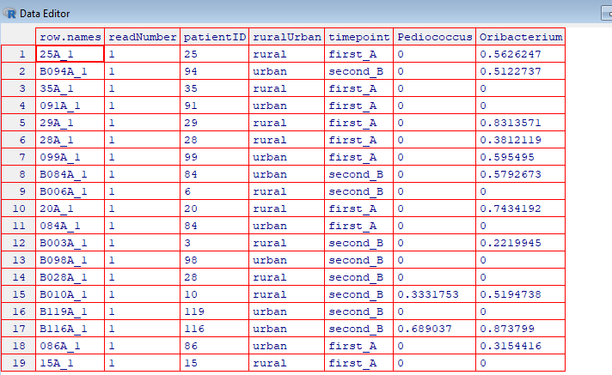
After we filter, only the rows for which the readNumber was 1 are left…
edit(myT)

Slide 44
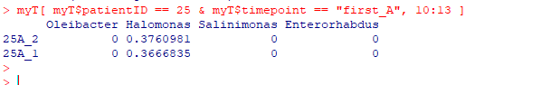
The ability to quickly subset data tables is one of the most powerful features of R
Return columns 10-13
for one subject at one timepoint

Slide 45
Here we separate the data we want to ordinate from the first
4 columns of metadata
https://github.com/afodor/metagenomicsTools/blob/master/src/classExamples/ch2018/quickOrdination.txt

Slide 46
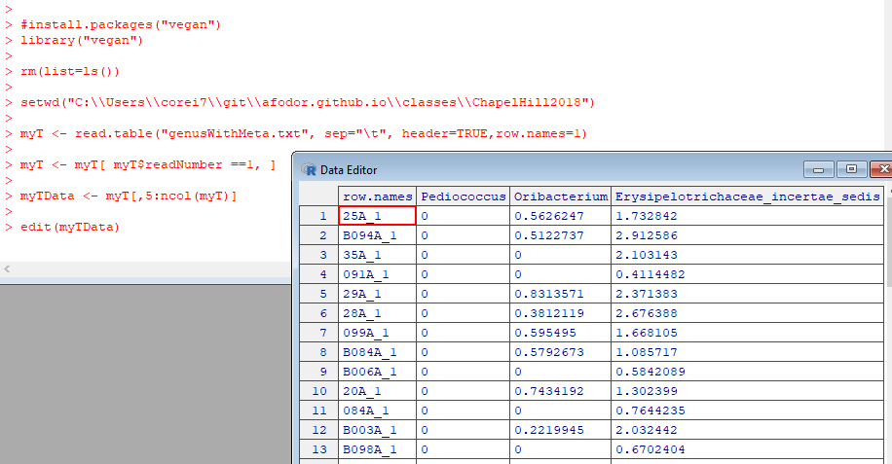
Return all
but the first 4
columns

Slide 47
Here we do the ordination/data compression
https://github.com/afodor/metagenomicsTools/blob/master/src/classExamples/ch2018/quickOrdination.txt

Slide 48
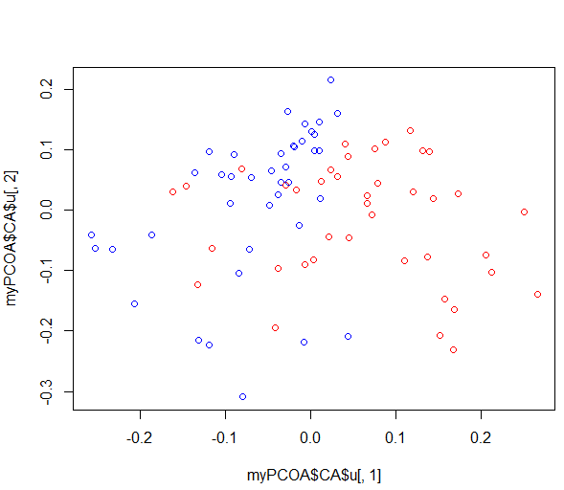
And plot the results
https://github.com/afodor/metagenomicsTools/blob/master/src/classExamples/ch2018/quickOrdination.txt

Slide 49
This graph is not quite publication ready….

Slide 50
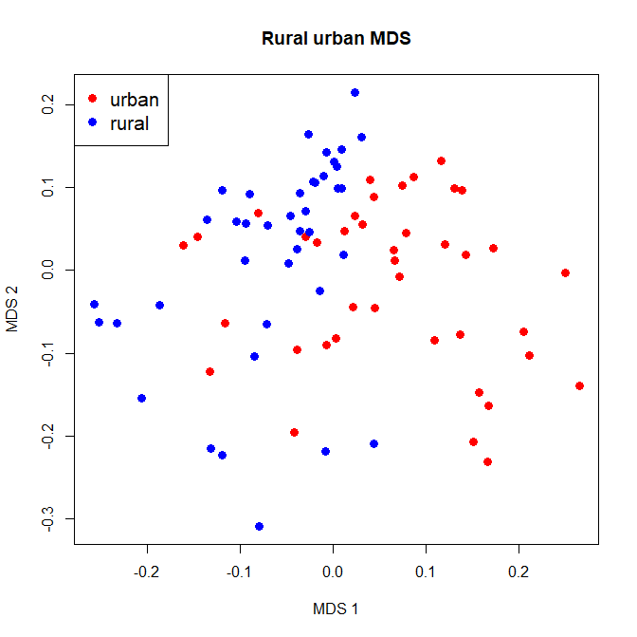
plot(myPCOA$CA$u[,1], myPCOA$CA$u[,2],col = ifelse(myT$ruralUrban == "rural", "red", "blue"),xlab="MDS 1", ylab="MDS 2", main="Rural urban MDS", pch=19,cex=1.3)
legend( "topleft", legend=c("urban", "rural"), col=c("red","blue"), pch=19,cex=1.3 )
We can pass options to our plot function to make the graph a little easier to see and a legend
Google searches help us find these commands

Slide 51
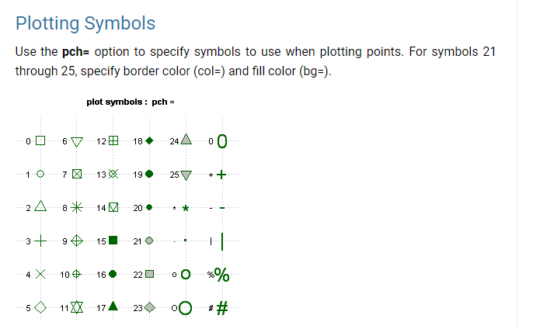
https://www.statmethods.net/advgraphs/parameters.html

Slide 52
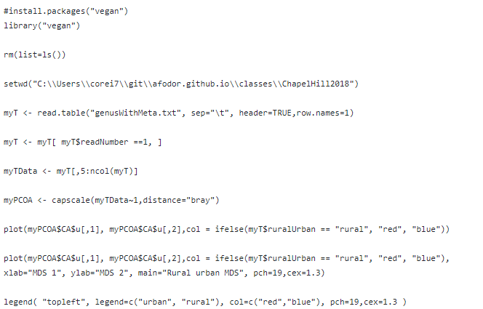
Here is our script so far…
https://github.com/afodor/metagenomicsTools/blob/master/src/classExamples/ch2018/quickOrdination.txt

Slide 53
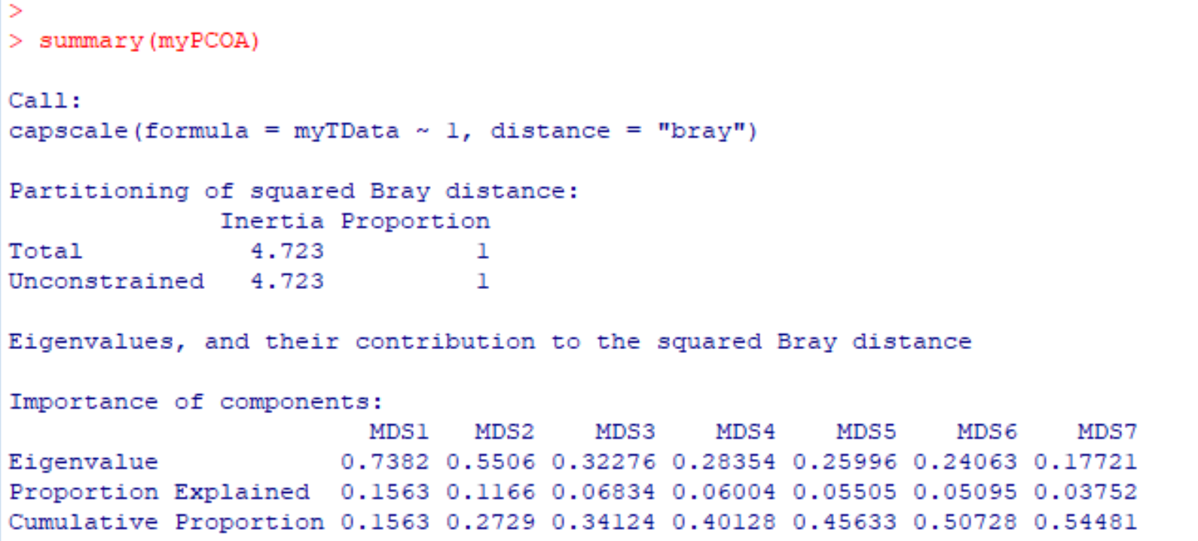
We can make one more refinement. How much duplicate information was there in the taxa?
That is, how much were the taxa correlated? How good was our compression?
We can use the “summary” command and R will yield this information…
more details at http://afodor.github.io/classes/stats2015/Lecture19.pptx

Slide 54
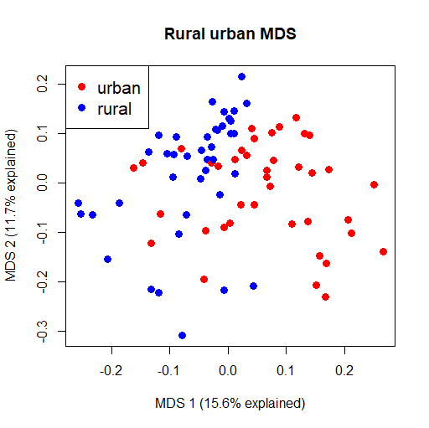
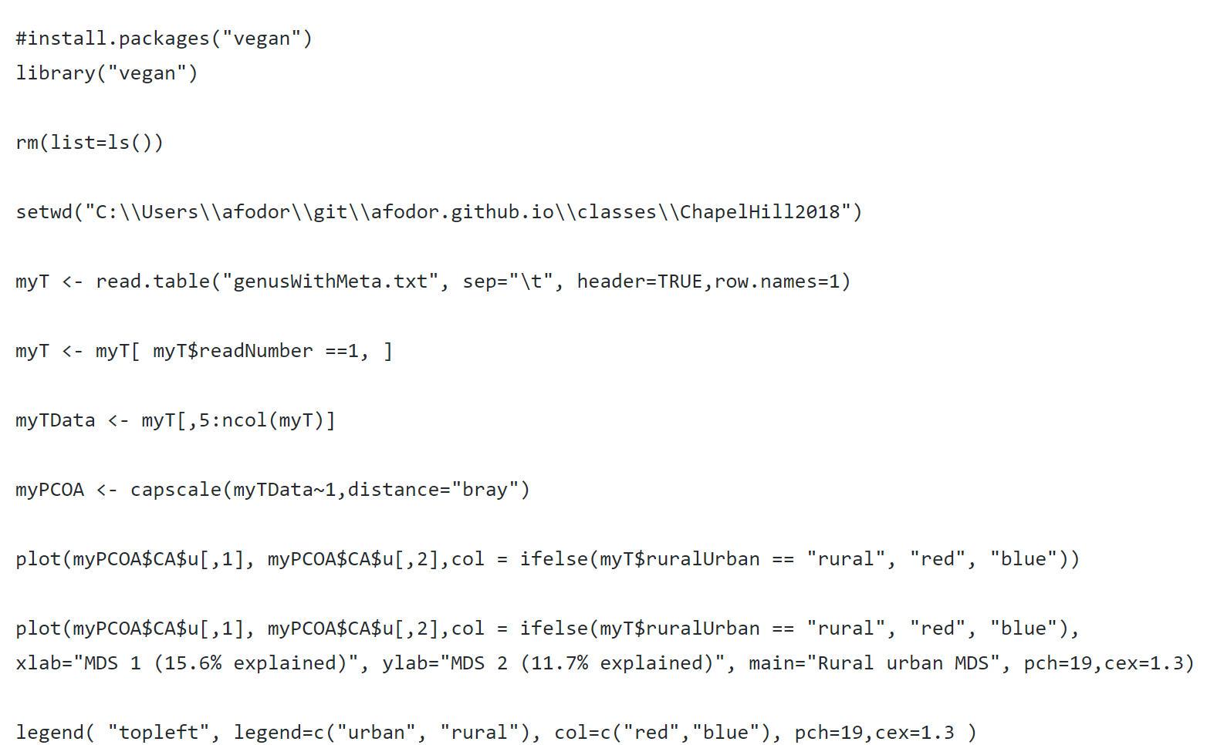
We can (in this case manually) add this to our graph script…
https://github.com/afodor/metagenomicsTools/blob/master/src/classExamples/ch2018/quickOrdination.txt

Slide 55
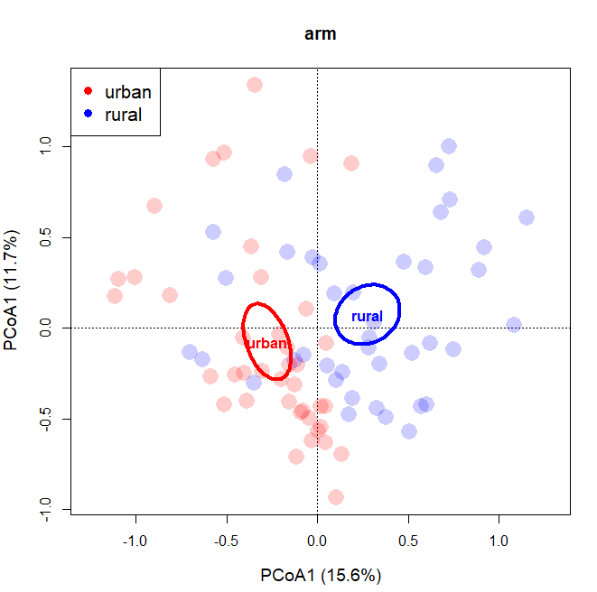
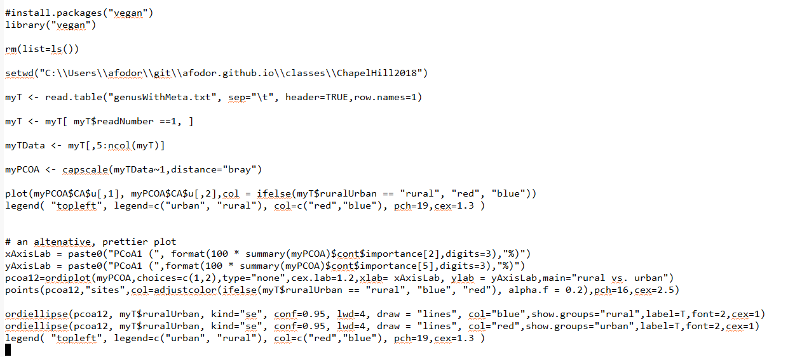
We can do this more elegantly and without hard-coding the numbers in the axes
(and draw confidence intervals)
https://github.com/afodor/metagenomicsTools/blob/master/src/classExamples/ch2018/quickOrdination.txt

Slide 56
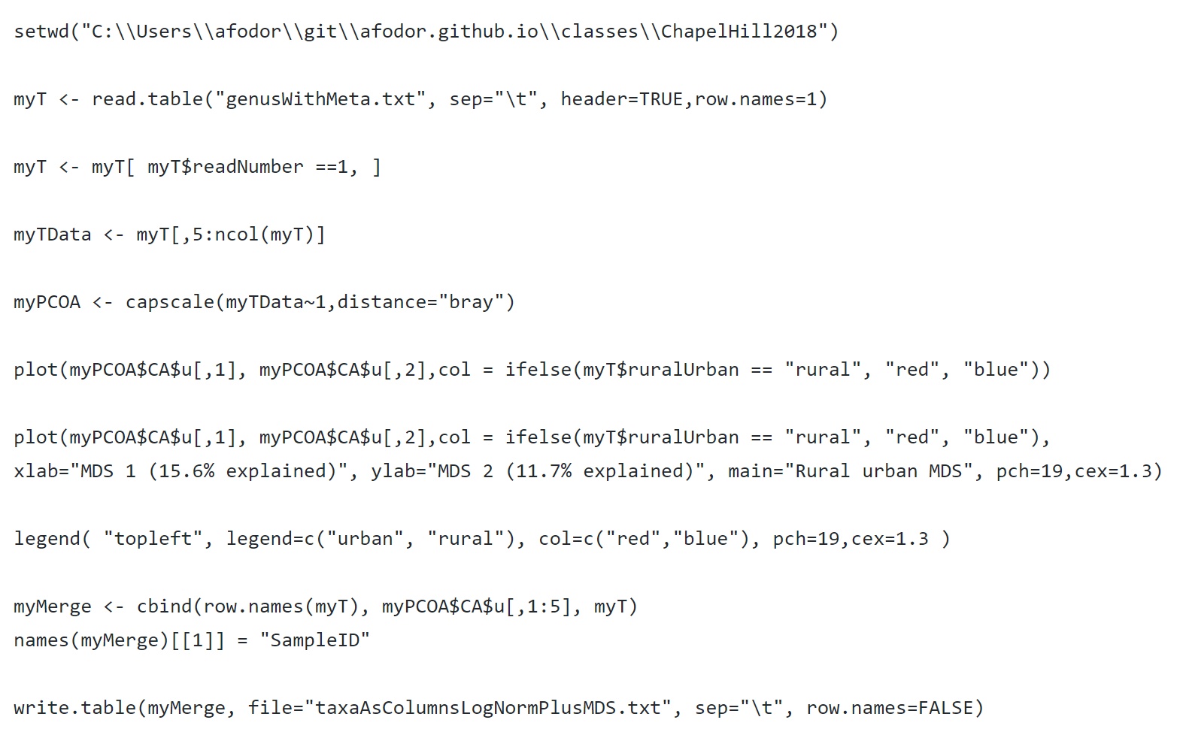
And, finally, we might want to write one file with the metadata, taxa information and MDS axes…

Slide 57
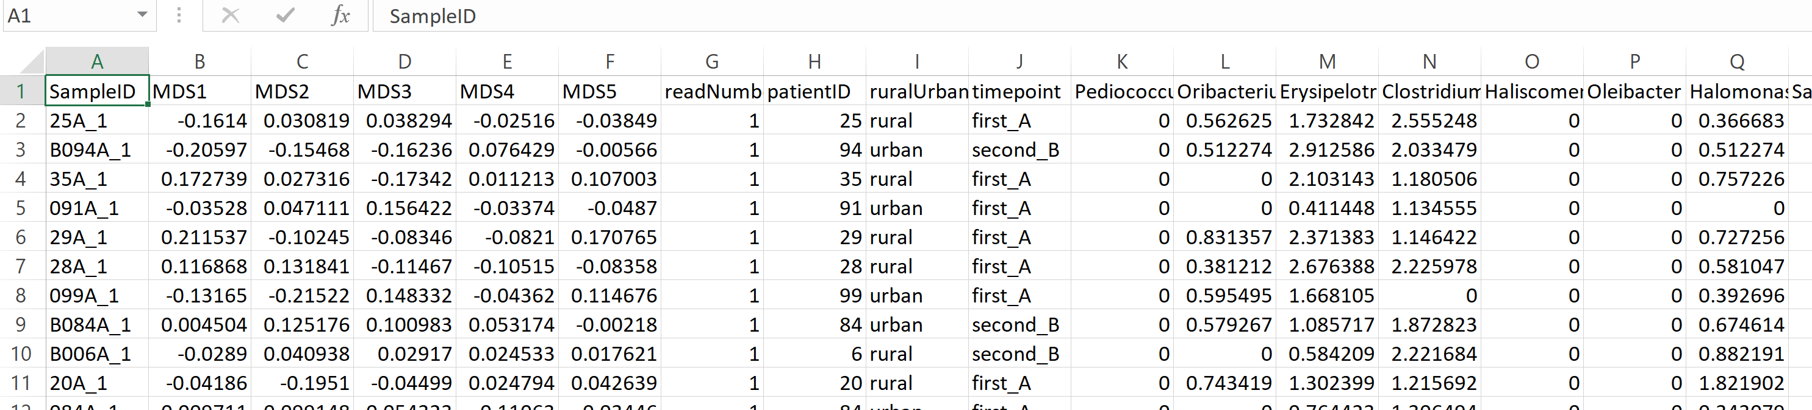
This is now ready to be inputted into any application (or read in by the next R script….)

Slide 58
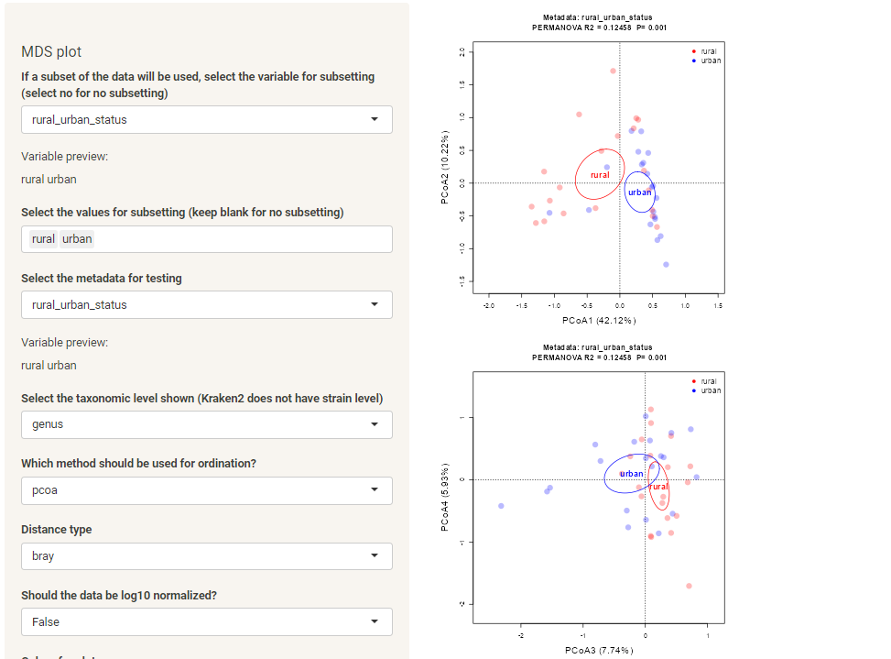
Or we can do the same thing in a few clicks with our “plotmicrobiome” tool
The permanova test is a
non-parametric test that checks
the distance of the points with a metadata
category against some number of permutations

Slide 59


It is straight-forward to perform this test from our code window..
https://github.com/afodor/metagenomicsTools/blob/master/src/classExamples/ch2018/quickOrdination.txt

Slide 60

Using ordination on metagenomics data is not without controversy…
This paper argues that different distance metrics make different assumptions about mean-variance
relationships, and hence you can think you are looking at a difference in means between two groups but
really it is a difference in variance…
This is interesting (and worthy of study) but in practice reviewers are unlikely to give you too much trouble…
These authors recommend approaching datasets taxa by taxa (or gene by gene), which is what we will turn to next..

Slide 61
Normalizing your data
PCA Ordination
Graphing everything into one big PDF ball
Some Simple Statistical Models
Some Not So Simple Statistical Models

Slide 62
We have a number of “metadata” columns in our spreadsheet that we might be interested in…..
Before we start to build statistical models, it would be useful to be able to graph out the entire spreadsheet.
The ability to make visualizations of very complex datasets is one of the great strengths of R.
We are going to make a multi-page PDF “ball” where each page of the PDF is an MDS axes (or taxa)
graphed out against all of the metadata

Slide 63

We start by defining which columns in our spreadsheet we will want to be on our y axes
(Input file for this section can be found at
https://github.com/afodor/metagenomicsTools/blob/master/src/classExamples/ch2018/pdfBall.txt

Slide 64

There are about 350 columns that we are interested in (but as we will see we will filter some of those away)

Slide 65

Here is a script to make a “PDF ball” of all of our data columns vs. subject id
Open up a PDF file for writing in our output directory
https://github.com/afodor/metagenomicsTools/blob/master/src/classExamples/ch2018/pdfBall.txt

Slide 66
Here is a script to make a “PDF ball” of all of our data columns vs. subject id
Remember the patientIDs (will be our x-axis)
https://github.com/afodor/metagenomicsTools/blob/master/src/classExamples/ch2018/pdfBall.txt

Slide 67
Here is a script to make a “PDF ball” of all of our data columns vs. subject id
Iterate over our data columns
https://github.com/afodor/metagenomicsTools/blob/master/src/classExamples/ch2018/pdfBall.txt

Slide 68
Here is a script to make a “PDF ball” of all of our data columns vs. subject id
Select out the ith column for our y-axis
https://github.com/afodor/metagenomicsTools/blob/master/src/classExamples/ch2018/pdfBall.txt

Slide 69
Here is a script to make a “PDF ball” of all of our data columns vs. subject id
Only taxa that are at least 25% non-zero
https://github.com/afodor/metagenomicsTools/blob/master/src/classExamples/ch2018/pdfBall.txt

Slide 70
Here is a script to make a “PDF ball” of all of our data columns vs. subject id
The name of our y-axis
https://github.com/afodor/metagenomicsTools/blob/master/src/classExamples/ch2018/pdfBall.txt

Slide 71
Here is a script to make a “PDF ball” of all of our data columns vs. subject id
Make the box-plot
https://github.com/afodor/metagenomicsTools/blob/master/src/classExamples/ch2018/pdfBall.txt

Slide 72
Here is a script to make a “PDF ball” of all of our data columns vs. subject id
Important: tell R to close the PDF file
https://github.com/afodor/metagenomicsTools/blob/master/src/classExamples/ch2018/pdfBall.txt

Slide 73


We end up with a 91 page PDF ball that shows the MDS axes and taxa graphed by patient ID.
We see a strong subject-effect. The tendency of the microbiome to be stable over the two time points.

Slide 74
With a few more lines of “stupid R tricks”, we can actually add the datapoints to the boxplots…
https://github.com/afodor/metagenomicsTools/blob/master/src/classExamples/ch2018/pdfBall.txt

Slide 75


With a few more lines of “stupid R tricks”, we can actually add the datapoints to the boxplots…

Slide 76

We can easily extend our boxplots to the other metadata in our file..
https://github.com/afodor/metagenomicsTools/blob/master/src/classExamples/ch2018/pdfBall.txt

Slide 77
We can easily extend our boxplots to the other metadata in our file..
Do 4 graphs per page
https://github.com/afodor/metagenomicsTools/blob/master/src/classExamples/ch2018/pdfBall.txt

Slide 78
We can easily extend our boxplots to the other metadata in our file..
Plot vs. subject
Plot vs. timepoint
Plot vs. rural/urban
A blank plot (to make the 4th plot on each page)
https://github.com/afodor/metagenomicsTools/blob/master/src/classExamples/ch2018/pdfBall.txt

Slide 79

Visually, we see strong separation by
subject;
Little separation by timepoint
Strong separation by rural/urban

Slide 80

And in our PDF ball, we have this view for every non-rare taxa in our dataset
You can look at the pdf ball here: http://afodor.github.io/classes/ChapelHill2018/pdfBall.pdf

Slide 81

Our plot microbiome tool can give us commonly used diversity metrics:
Mathematical treatment of diversity, evenness and richness:
https://afodor.github.io/classes/stats2017/Lecture21.pptx

Slide 82

Barcode plots are likewise straight-forward to create…

Slide 83
Normalizing your data
PCA Ordination
Graphing everything into one big PDF ball
Some Simple Statistical Models
Some Not So Simple Statistical Models

Slide 84

For each MDS axis or taxa, we can also run statistical tests (in addition to doing the visualization)
https://github.com/afodor/metagenomicsTools/blob/master/src/classExamples/ch2018/quickSimpleStats.txt

Slide 85
For each MDS axis or taxa, we can also run statistical tests (in addition to doing the visualization)
Data structures to hold our p-values
https://github.com/afodor/metagenomicsTools/blob/master/src/classExamples/ch2018/quickSimpleStats.txt

Slide 86
For each MDS axis or taxa, we can also run statistical tests (in addition to doing the visualization)
A t-test for our two timepoints
A one-way ANOVA for subject id
A t-test for our rural vs. urbal
https://github.com/afodor/metagenomicsTools/blob/master/src/classExamples/ch2018/quickSimpleStats.txt

Slide 87


By examining the distribution of p-values, we can get a sense of the strength of associations with our meta-data

Slide 88


The histogram of all p-value is uniform when the null hypothesis is expected to be true!
Simulate an experiment where the null
hypothesis is always true…
Don’t use simple thresholds of p <0.05 for cases where you have evaluate multiple hypotheses!

Slide 89


One alternative:
Use as a p-value threshold Bonferroni correction.
The desired threshold / number of tests.
In this case 0.05 / 20000 = 2.5e-06
None of our p-vals reach this threshold..
At this threshold, there is a 5% chance of any false positives

Slide 90
Bonferroni correction is sometimes considered too conservative for genomics experiments.
At small sample sizes, you might have few genes with p-values smaller than the
Bonferroni thresholds.
A less conservative alternative, false discovery rate.
At a 5% false discovery rate, we expect 5% of our hits to be false positives.
This is less conservative than Bonferroni correction, where there is a 5% chance
that any of our hits are false positives.

Slide 91


One straight-forward approach to finding genes at a given false-discovery rate
Benjamini and Hochberg FDR
1. Rank all the p-values (smallest first). The rank of each value = K
2. Calculate N * p / k
where N = the # of hypotheses that you are testing
p = the “raw” (uncorrected) p-value.
3. Start at the top of the list. Go down to N * p / k > threshold
(e.g. 0.10 for 10% FDR).
N * p = # of expected false positives at a given p-value
k = # of genes actually observed at that p-value

Slide 92
Note that for the first hit (smallest p-value),
Bonferroni correction is the same as BH FDR.
(Since if k=1,
N * p / K = N * p
which is the same as multiplying the p-value by the number of hypotheses to
do the correction)

Slide 93

Here are example results from DeSeq (a popular RNA-seq analysis tool)…
FDR adjusted
p-values..
Raw p-values
You can access BH FDR correction from r with p.adjust( uncorrectedPValues, method=“BH”)

Slide 94

In our script, we can write out the adjusted and un-adjusted p-values for other applications to use
https://github.com/afodor/metagenomicsTools/blob/master/src/classExamples/ch2018/quickSimpleStats.txt

Slide 95

And we end up with our sorted list of taxa associated with our metadata

Slide 96

R gives you flexibility to make any view of the data you want….
https://github.com/afodor/metagenomicsTools/blob/master/src/classExamples/ch2018/meanVsGraph.txt

Slide 97


https://github.com/afodor/metagenomicsTools/blob/master/src/classExamples/ch2018/meanVsGraph.txt

Slide 98


This is a view I’ve used in multiple publications…
https://journals.plos.org/plosone/article?id=10.1371/journal.pone.0045001
The Adult Cystic Fibrosis Airway Microbiota Is Stable over Time and Infection
Type, and Highly Resilient to Antibiotic Treatment of Exacerbations
Rifaximin is associated with modest, transient decreases in multiple taxa in the gut microbiota
of patients with diarrhoea-predominant irritable bowel syndrome

Slide 99

We can also taxa-by-taxa tests using the plot microbiome tool (after using the data filter tab)

Slide 100

We can also taxa-by-taxa tests using the plot microbiome tool (after using the data filter tab)

Slide 101

The plotmicrobiome tool can make some very nice publication ready views of our inference results…

Slide 102

And the plot microbiome tool can give us box plots (equivalent to our big pdf ball)

Slide 103
Normalizing your data
PCA Ordination
Graphing everything into one big PDF ball
Some Simple Statistical Models
Some Not So Simple Statistical Models

Slide 104
Our simple t-test here is not
a “publishable” test as we ignore
that there are two timepoints for
each subject

Slide 105
One alternative: Do t-tests at both times separating the data
Another alternative: Mixed linear models
(http://afodor.github.io/classes/stats2018/Lecture18.pptx )

Slide 106
Model repeated samples from the same person, or people within hospitals, or mice within cages
Y = drug + (hospital) + error
Fixed Effects
Random Effects
Assumptions
Random effects are i.i.d.
Variance in groups are equal (homoscedasticity)
Hospital effects are normally distributed with a mean of 0
In effect, each hospital adds some value to the fixed effects and this
value is normally distributed with a mean of 0…

Slide 107



More information in two books (both can be downloaded from campus via springer links):
http://link.springer.com/
This book is more mathematical and very thorough;
a good reference
This book is more accessible and covers a broader
range of topics (beyond mixed-models)

Slide 108



There is a good deal of current interest in the literature in explicitly modeling the zeros
(these are often called “zero inflated models”)
This one is called the zero inflated beta distribution
3 parameter model
One parameter to absorb the zeros
Two parameters to fit the rest of the data

Slide 109
Machine learning methods are easy to do in R…
https://github.com/afodor/metagenomicsTools/blob/master/src/classExamples/ch2018/randomForest.txt

Slide 110
Learning more…

Slide 111


Ese
Essential for learning all the weirdness of R (does not try and teach stats!)

Slide 112
Helpful books on mixed linear models
http://link.springer.com/
This book is more mathematical and very thorough;
a good reference
This book is more accessible and covers a broader
range of topics (including zero-inflated models)

Slide 113



http://www.amazon.com/gp/offer-listing/025608338X/ref=sr_1_5_olp?ie=UTF8&qid=1357529565&sr=8-5&keywords=applied+linear+statistical+models&condition=used

Slide 114

Either edition of this book is fine, but new or used is going to be around $40.
It really is an outstanding book (but dense!). It is worth the investment of time and money

Slide 115

This is a great book, but is insanely over-priced!
If you think you will be implementing Bayesian stats in your pipelines, it might be worth having

Slide 116

Doing Bayesian Data Analysis: A Tutorial with R and BUG. John K. Kruschke. More approachable, but also not quite as clear or concise as the Bolstad book. Very nice chapters on Monte Carlo approaches to Bayesian analysis, but a bit heavy on the Bayesian proselytizing for my taste. Also quite expensive. Overall, though, a very engaging text. If you get the Google electronic edition, make sure that your device(s) can show the scanned versions (which are DRM’ed ) as the equations in the default view are illegible.
Be sure to read sample
chapters on the device
of your choice to make
sure formatting is ok
before purchasing…

Slide 117

Recommended:
It’s about $30-$40 and will make your life easier, but is not strictly required.
More useful as a reference than as a tutorial…

Slide 118

On-line resources:
Vassar stats book
http://vassarstats.net/textbook/
You will need at least one book that covers canonical statistics.
Start with this one (it is free) and then if it is not working for you, consider alternatives…

Slide 119


Legal download:
http://www-stat.stanford.edu/~tibs/ElemStatLearn/printings/ESLII_print10.pdf

Slide 120

A less mathematical treatment of the same material….
http://www-bcf.usc.edu/~gareth/ISL/

